Slide 1



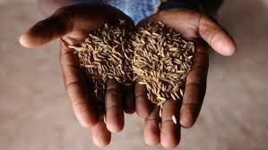
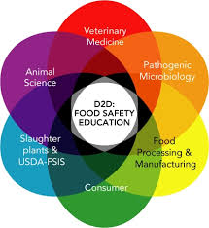
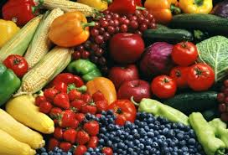


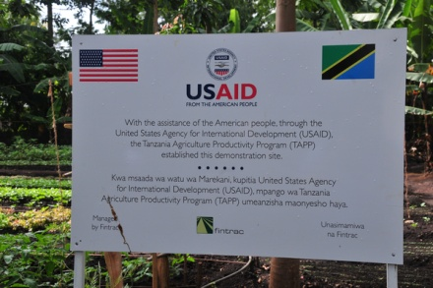
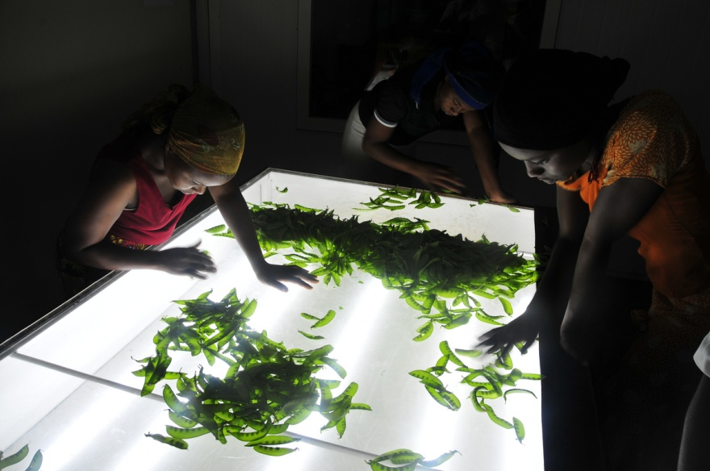
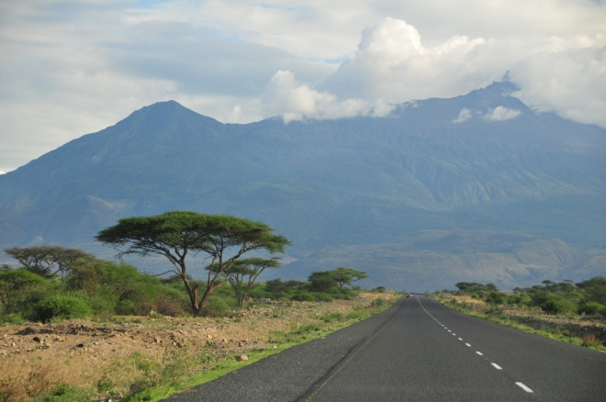
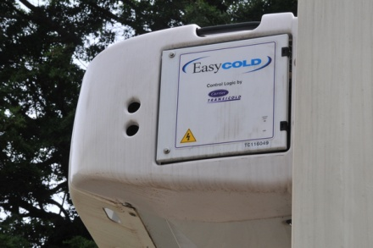
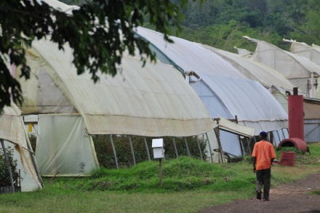
Doing Cold Smarter
Setting the Stage for Ag Transformation

Slide 2
The New Cold Economy
Introducing Liquid Air into food & agriculture.
Protect value chain from Farm to Fork.
Farm
Pre-cooling
Plant
Processing
Packaging
Distribution
Market Development
Cold Storage
Storage
Consumer
Consumer Behavior
Refrigerated Transportation

Slide 3
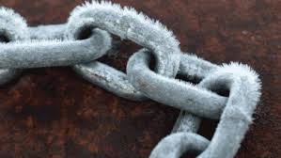
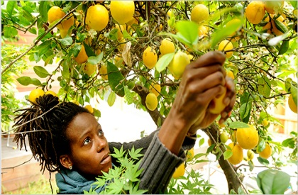
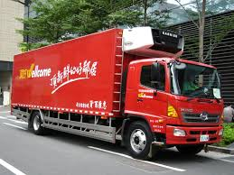
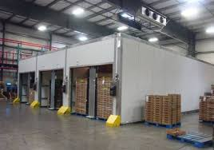
The New Cold Economy
Introducing Liquid Air into food & agriculture.
Protect value chain from Farm to Fork.
Links in the chain – more details:
  Harvest/Pre-Cooling.
  Collection/Transport.
  Processing/Packing/Sorting.
  Wholesale/Regional Distribution.
  Trade/Middleman/Transport.
  Storage/Transport.
  Retail/Distribution.

Slide 4
The New Cold Economy
Other applications along the agriculture
& food value chain include:
  Fertilizer production.
  Food freezing.
  Food processing.
  Refrigerated transport.
  Cold storage.
  Truck/tuk-tuk delivery to consumers.
  Modern retail expansion.

Slide 5
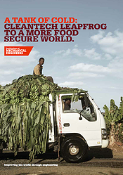

The New Cold Economy
Liquid Air: Leapfrog Solution linking
renewable energy to cold and power.
Can trigger long-term transformation in agriculture & food production.
Possible future effects:
  One: Better Food Security.
  Two: Improved Food Safety.
  Three: Enhanced Nutrition.
  Four: Poverty Reduction.
  Five: A Cleaner Environment.

Slide 6
One: Better Food Security
Current Situation:
  High post-harvest losses.
  Increased stresses if local harvests fail.
  High consumer prices outside producing regions.
The Change:
  Reduction in losses.
  Increased food supplies.
  Lower consumer prices.
  Ability to ship food to distressed areas.
  Higher farm income.

Slide 7
Two: Improved Food Safety
Current Situation:
  Consumption of sub-standard products.
  High risk for food-borne illnesses.
  Unavailable and/or poorly transported vet drugs.
The Change:
  Less fruit/vegetable spoilage and damage.
  Safer dairy/meat production & transport.
  Reduction in pathogens/illness in people & animals.
  Improved incomes, health & productivity.

Slide 8
Three: Enhanced Nutrition
Current Situation:
  Stunted development of meat/poultry sector.
  Limited access to protein.
  Limited access to fruit and vegetables.
  High prices outside producing regions.
The Change:
  Increased access to protein.
  Increased access to fruit & vegetables.
  Improved nutrition of available foods.
  Improved health outcomes.

Slide 9
Four: Poverty Reduction
Current Situation:
  Low productivity.
  Low investment.
  Many farmers stay poor.
The Change:
  Improved productivity and quality.
  Access to regional and global markets (tourism).
  Trigger virtuous cycle of investment.
  Can serve as a base for further development
  (value-added & food processing).

Slide 10
Five: A Cleaner Environment
Current Situation:
  High pollution from burning diesel.
  Impact of transporting diesel.
  Price volatility.
  Land, water & other resources make wasted food.
The Change:
  Less resource use.
  Lower GHG, PM and NOx.
  More reliable energy access.
  Less price instability.

Slide 11
Six: Beyond Food & Agriculture
The Change:
  Medical-related: Better health outcomes.
  Distributed Power: Rural development.
  Distributed Power: Improving urban conditions.
  Overall: Reduced fuel subsidies & budget stresses.
  Overall: Forego costs of building/operating grids.
  Overall: Boost access to water.
Technology can help both people
& the environment by unlocking
economic potential in ag & beyond
-- all while boosting the bottom line.

Slide 12
The New Cold Economy
Other applications beyond the agriculture
& food value chain include:
  Medical cold chain & facilities.
  Creation of local/micro grids (urban/rural).
  Air conditioning (transport/building).
  Backup power (hospital/tourism).
Cold Hubs: Create synergies & economies
of scale between several applications.
These items can be the basis for a
New Cold Economy.

Slide 13

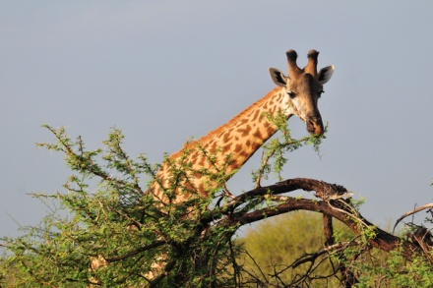

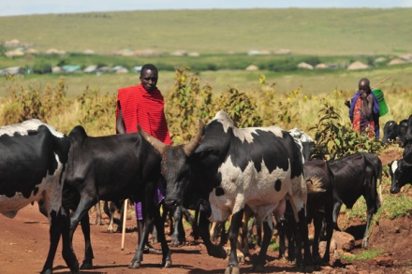
Developing Country Example: Tanzania

Slide 14
Tanzania Cold Chain
Ag employs around 80% of the population.
Contributes 30% of export earnings.
Major Products:
  Fiber (sisal, cotton).
  Beverages (coffee, tea).
  Sugar.
  Edible Oils.
  Grains (a diverse range of cereals and legumes).
  Horticulture (temperate and tropical
  fruits, vegetables & flowers).
Sources: Tanzanian Government, Tanzanian Horticultural Association (TAHA)

Slide 15
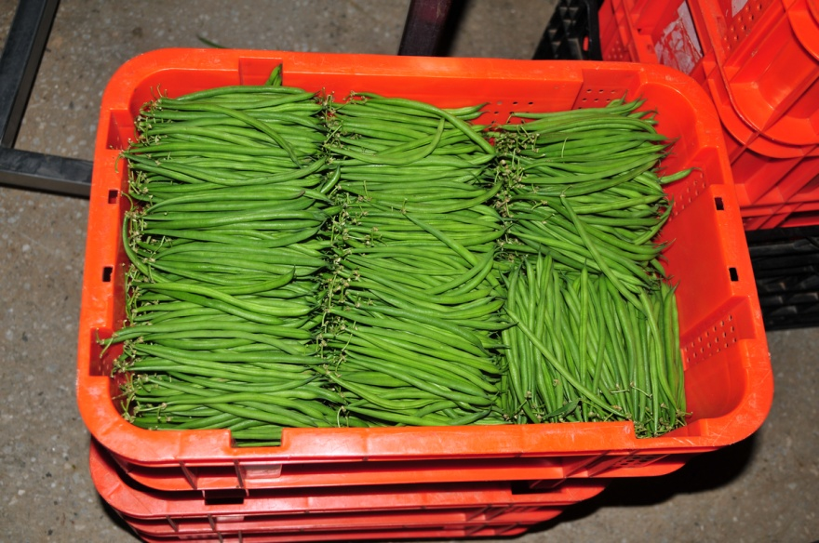
Tanzania Cold Chain
Horticulture production in Tanzania is diverse.
  Both tropical and temperate products that include citrus, mangoes, papaya, tomatoes, onions, cabbages & vegetables.
The use of improved seed, fertilizer and chemicals is generally low.
  Average yields around only 50% of potential.
Exports and processed product channels are underdeveloped.
  90% of fruit & vegetables sold fresh
  at low prices.
Sources: Tanzanian Government, Tanzanian Horticultural Association (TAHA)

Slide 16
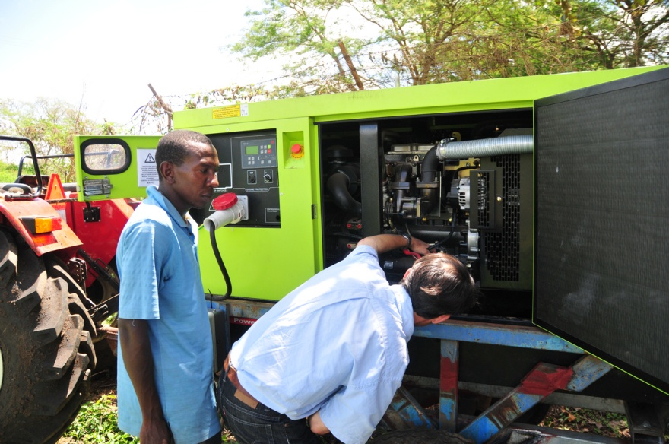
Tanzania Cold Chain
Post-harvest losses are around 30-40% of horticultural production.
There is no true supply chain:
  Lack of cooling after harvest & cold storage.
  Lack of refrigerated transport.
  Little or no infrastructure.
  Lack of consistent electricity.
  Problem worst in wet season when road conditions are poor & crops exposed to elements.
Sources: Tanzanian Government, Tanzanian Horticultural Association (TAHA)

Slide 17
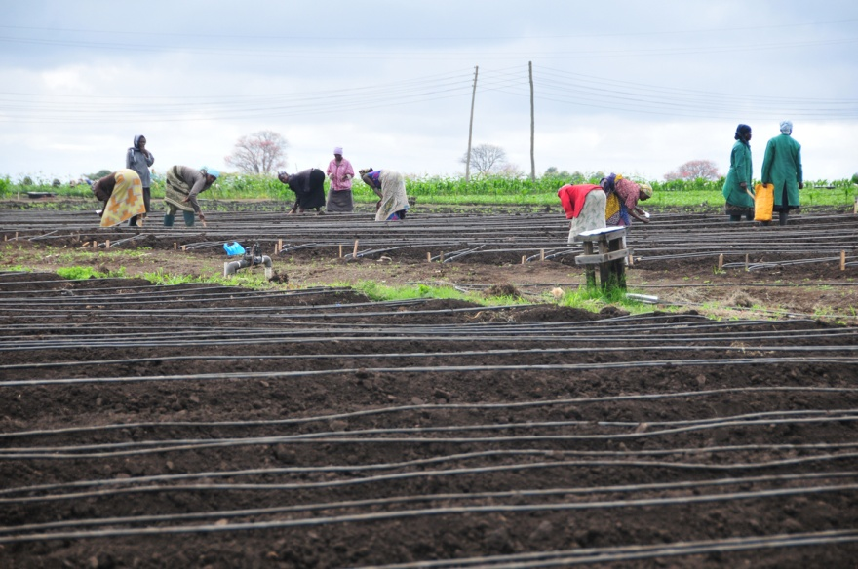
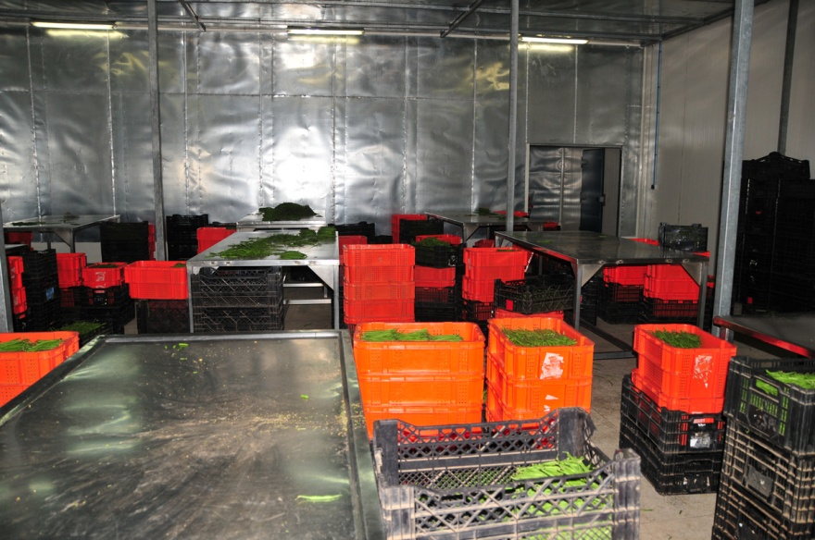
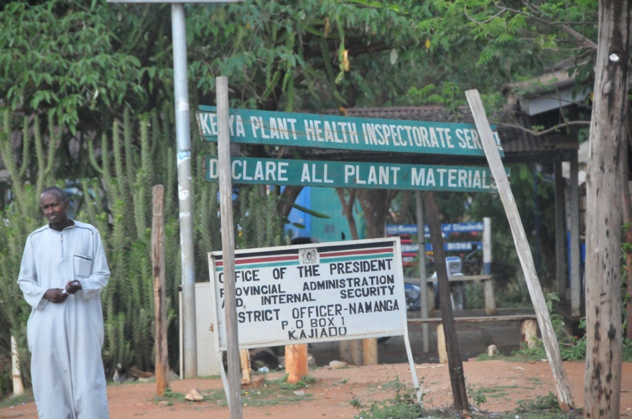
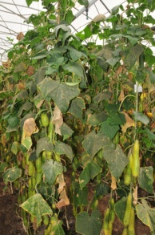
Tanzania Cold Chain

Slide 18
Tanzania Cold Chain

Slide 19
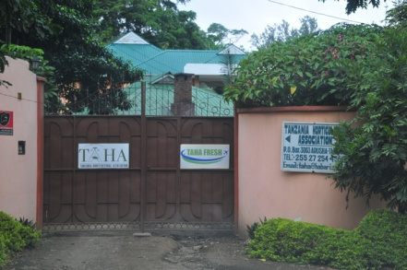
Tanzania Cold Chain
Public Private Partnership (PPP).
Public/Donors.
  Public Goods – infrastructure, public policy,
  seed capital, education & health.
Private Sector.
  Profit Drives Sustainability – investment in technology, scaling production, food processing/value added, finding local
  & overseas markets for products.
Market Driven: Markets willing to pay
  Sourcing for local/global markets.

Slide 20
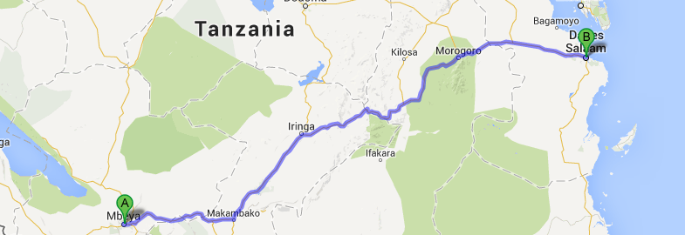

Tanzania Cold Chain
Introducing liquid air could cut cold chain costs.
Passion fruits from Mbeya to Dar es Salaam by Truck.
$57.80 versus $131.52 for diesel.
Source: Dearman Engine

Slide 21

Tanzania Cold Chain
Introducing liquid air could cut cold chain costs.
Passion fruits from Mbeya to Dar es Salaam by Truck.
$57.80 versus $131.52 for diesel.
Reducing PHL to 15% from the current 30% with current cold chain technologies could provide
  1.9 million ton of fresh foods each year.
  Valued at $432 million annually.
Source: Dearman Engine, Lisa Kitonja

Slide 22

Final Thoughts
All technologies are trade-offs but
Liquid Air offers possible “Triple Win”.
  Social/People.
  Economic/Profits.
  Environment/Planet.
All could move forward together:
  Benefits trickle down to poor & farmers.
  The business model is commercially sound.
  Environmental improvements are measurable.

Slide 23
Final Thoughts
Liquid Air is not a panacea.
Any technology is only a partial solution.
Need other supporting changes.
  Infrastructure (roads and power).
  Policy (legal, trade, taxes and regulation).
  Access to credit and technology.
  Many other parts of the equation.
Create new business opportunities.
Improve Farm Incomes.
Feed the World.

Slide 24

Thank you!
Eric Trachtenberg
Director, Food & Agriculture Sector
McLarty Associates
900 Seventeenth St, Suite 800
Washington, DC 20006 USA
1-202-419-1420

